Slide 1
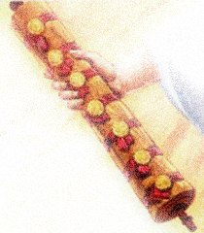
Worthy is the Lamb Revelation 5

Slide 2
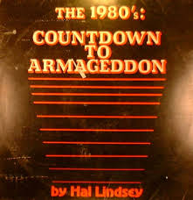
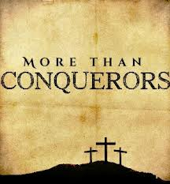
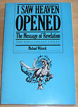
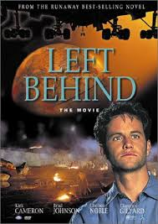
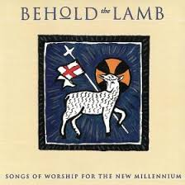
Worthy is the Lamb (Rev 5)

Slide 3
Worthy is the Lamb (Rev 5)
Category 1
Focus on earth
“Late great planet earth”
“Left behind”
“Countdown to Armageddon”
Category 2
Focus on heaven
“More than Conquerors”
“Behold the Lamb”
“I saw heaven opened”

Slide 4
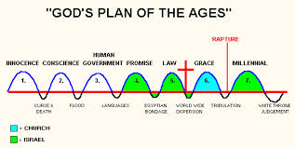
Worthy is the Lamb (Rev 5)
Darby’s “Rediscovered Truths”

Slide 5
Worthy is the Lamb (Rev 5)
1. The sealed scroll v.1-4
Then I saw in the right hand of him who sat on the throne a scroll with writing on both sides and sealed with seven seals. And I saw a mighty angel proclaiming in a loud voice, ‘Who is worthy to break the seals and open the scroll?’ But no one in heaven or on earth or under the earth could open the scroll or even look inside it. I wept and wept because no one was found who was worthy to open the scroll or look inside.

Slide 6
Worthy is the Lamb (Rev 5)
1. The sealed scroll v.1-4
‘Take a scroll and write on it all the words I have spoken to you concerning Israel, Judah and all the other nations from the time I began speaking to you in the reign of Josiah till now. Perhaps when the people of Judah hear about every disaster I plan to inflict on them, they will each turn from their wicked ways; then I will forgive their wickedness and their sin.’ Jeremiah 36:2-3

Slide 7
Worthy is the Lamb (Rev 5)
1. The sealed scroll v.1-4
Then I looked, and I saw a hand stretched out to me. In it was a scroll, which he unrolled before me. On both sides of it were written words of lament and mourning and woe (Ezekiel 2:9-10).

Slide 8
Worthy is the Lamb (Rev 5)
The sealed scroll v.1-4
Who is worthy to break seals and open the scroll?
No-one – not even an angel!
Concerning this salvation, the prophets, who spoke of the grace that was to come to you, searched intently…trying to find out the time and circumstances to which the Spirit of Christ in them was pointing when he predicted the sufferings of the Messiah and the glories that would follow. It was revealed to them that they were not serving themselves but you, when they spoke of the things that have now been told you by those who have preached the gospel to you by the Holy Spirit sent from heaven. Even angels long to look into these things. 1 Peter 1:10-12

Slide 9
Worthy is the Lamb (Rev 5)
The sealed scroll v.1-4
John’s tears
I wept and wept because no one was found who was worthy to open the scroll or look inside. (v.4)

Slide 10
Worthy is the Lamb (Rev 5)
The sealed scroll v.1-4
The Lion (v.5)
Then one of the elders said to me, ‘Do not weep! See, the Lion of the tribe of Judah, the Root of David, has triumphed. He is able to open the scroll and its seven seals.’

Slide 11
Worthy is the Lamb (Rev 5)
The sealed scroll v.1-4
The Lion (v.5)
The Lion of the tribe of Judah
You are a lion’s cub, Judah; you return from the prey, my son. Like a lion he crouches and lies down, like a lioness – who dares to rouse him? The sceptre will not depart from Judah, nor the ruler’s staff from between his feet, until he to whom it belongs shall come and the obedience of the nations shall be his. (Genesis 49:9-10)

Slide 12
Worthy is the Lamb (Rev 5)
The sealed scroll v.1-4
The Lion (v.5)
The Lion of the tribe of Judah
The Root of David
A shoot will come up from the stump of Jesse; from his roots a Branch will bear fruit. In that day the Root of Jesse will stand as a banner for the peoples; the nations will rally to him, and his resting-place will be glorious. Isaiah 11:1,10

Slide 13
Worthy is the Lamb (Rev 5)
The sealed scroll v.1-4
The Lion (v.5)
The Lion of the tribe of Judah
The Root of David
Those who went ahead and those who followed shouted, ‘Hosanna!’ ‘Blessed is he who comes in the name of the Lord!’ ‘Blessed is the coming kingdom of our father David!’ ‘Hosanna in the highest heaven!’ (Mark 11:9-10)

Slide 14
Worthy is the Lamb (Rev 5)
The sealed scroll v.1-4
The Lion (v.5)
The Lamb (v:6-7)
Then I saw a Lamb, looking as if it had been slain, standing at the centre of the throne, encircled by the four living creatures and the elders. The Lamb had seven horns and seven eyes, which are the seven spirits of God sent out into all the earth. He went and took the scroll from the right hand of him who sat on the throne.

Slide 15
Worthy is the Lamb (Rev 5)
The sealed scroll v.1-4
The Lion (v.5)
The Lamb (v:6-7)
What John heard
What John saw
Behold, the Lion of the tribe of Judah, the Root of David has conquered…
I saw a Lamb standing, as though it had been slain…and he took the scroll…

Slide 16
Worthy is the Lamb (Rev 5)
The sealed scroll v.1-4
The Lion (v.5)
The Lamb (v:6-7)
Each man is to take a lamb for his family, one for each household. The animals you choose must be year-old males without defect, and you may take them from the sheep or the goats. Take care of them until the fourteenth day of the month, when all the members of the community of Israel must slaughter them at twilight. On that same night I will pass through Egypt and strike down every firstborn of both people and animals, and I will bring judgment on all the gods of Egypt. I am the Lord. The blood will be a sign for you on the houses where you are, and when I see the blood, I will pass over you. No destructive plague will touch you when I strike Egypt. (Exodus 12:3, 5-6, 12-13)

Slide 17
Worthy is the Lamb (Rev 5)
The sealed scroll v.1-4
The Lion (v.5)
The Lamb (v:6-7)
He went and took the scroll from the right hand of him who sat on the throne (v.7)

Slide 18
Worthy is the Lamb (Rev 5)
The sealed scroll v.1-4
The Lion (v.5)
The Lamb (v:6-7)
God’s heavenly waiting room

Slide 19
Worthy is the Lamb (Rev 5)
The sealed scroll v.1-4
The Lion (v.5)
The Lamb (v:6-7)
The worship of the Lamb (v.8-14)
And when he had taken it, the four living creatures and the twenty-four elders fell down before the Lamb Each one had a harp and they were holding golden bowls full of incense, which are the prayers of God’s people. And they sang a new song… (v.8-9a)

Slide 20
Worthy is the Lamb (Rev 5)
The sealed scroll v.1-4
The Lion (v.5)
The Lamb (v:6-7)
The worship of the Lamb (v.8-14)
“You are worthy to take the scroll and open the seals”

Slide 21
Worthy is the Lamb (Rev 5)
The sealed scroll v.1-4
The Lion (v.5)
The Lamb (v:6-7)
The worship of the Lamb (v.8-14)
“You are worthy to take the scroll and open the seals”
“Worthy is the Lamb that was slain”

Slide 22
Worthy is the Lamb (Rev 5)
The sealed scroll v.1-4
The Lion (v.5)
The Lamb (v:6-7)
The worship of the Lamb (v.8-14)
“You are worthy to take the scroll and open the seals”
“Worthy is the Lamb that was slain”
“Praise and honour to God and to the Lamb” (v.13)

Slide 23
Worthy is the Lamb (Rev 5)
The sealed scroll v.1-4
The Lion (v.5)
The Lamb (v:6-7)
The worship of the Lamb (v.8-14)
“You are worthy to take the scroll and open the seals”
“Worthy is the Lamb that was slain”
“Praise and honour to God and to the Lamb” (v.13)
The trinity
Council of Nicaea 325 AD
Council of Constantinople 380 AD
Council of Chalcedon 451 AD

Slide 24
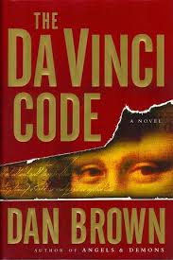
Worthy is the Lamb (Rev 5)
The sealed scroll v.1-4
The Lion (v.5)
The Lamb (v:6-7)
The worship of the Lamb (v.8-14)
“You are worthy to take the scroll and open the seals”
“Worthy is the Lamb that was slain”
“Praise and honour to God and to the Lamb” (v.13)
THE trinity

Slide 25
Worthy is the Lamb (Rev 5)
The sealed scroll v.1-4
The Lion (v.5)
The Lamb (v:6-7)
The worship of the Lamb (v.8-14)
“You are worthy to take the scroll and open the seals”
“Worthy is the Lamb that was slain”
“Praise and honour to God and to the Lamb” (v.13)
“Amen!”

Slide 26
Worthy is the Lamb (Rev 5)
The sealed scroll v.1-4
The Lion (v.5)
The Lamb (v:6-7)
The worship of the Lamb (v.8-14)
Conclusion. What constitutes true worship?

Slide 27
Worthy is the Lamb (Rev 5)
The sealed scroll v.1-4
The Lion (v.5)
The Lamb (v:6-7)
The worship of the Lamb (v.8-14)
Conclusion. What constitutes true worship?
Adoration “They fell down before the Lamb”.

Slide 28
Worthy is the Lamb (Rev 5)
The sealed scroll v.1-4
The Lion (v.5)
The Lamb (v:6-7)
The worship of the Lamb (v.8-14)
Conclusion. What constitutes true worship?
Adoration “They fell down before the Lamb”.
Harps and Incense

Slide 29
Worthy is the Lamb (Rev 5)
The sealed scroll v.1-4
The Lion (v.5)
The Lamb (v:6-7)
The worship of the Lamb (v.8-14)
Conclusion. What constitutes true worship?
Adoration “They fell down before the Lamb”.
Harps and Incense
New Song

Slide 30
Worthy is the Lamb (Rev 5)
The sealed scroll v.1-4
The Lion (v.5)
The Lamb (v:6-7)
The worship of the Lamb (v.8-14)
Conclusion. What constitutes true worship?
Adoration “They fell down before the Lamb”.
Harps and Incense
New Song “Blessing and honour, glory and power be unto him that sits on the throne and unto the Lamb, for ever and ever.

Slide 31
Worthy is the Lamb (Rev 5)
The sealed scroll v.1-4
The Lion (v.5)
The Lamb (v:6-7)
The worship of the Lamb (v.8-14)
Conclusion. What constitutes true worship?
“The kingdom of the world has become the kingdom of our Lord Jesus Christ and he will reign for ever and ever” (11:15). “It is done!” “Now the dwelling of God is with men , and he will live with them. They will be his people, and God himself will be with them and be their God” (21:3)

